Slide 1
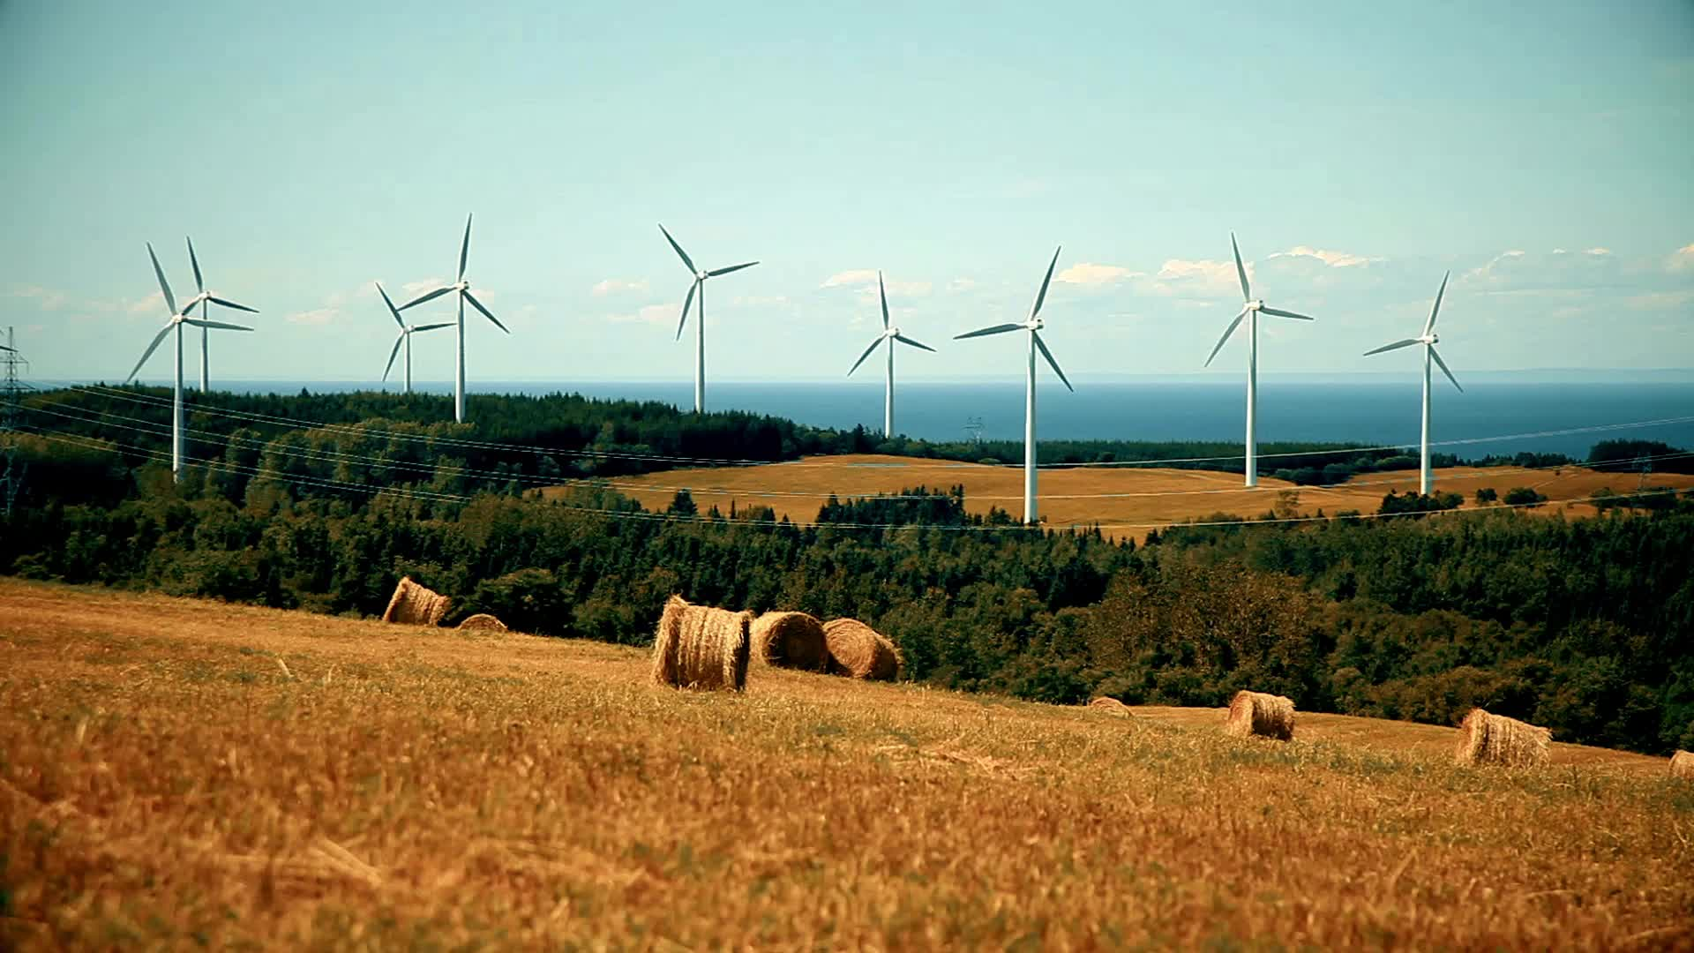
Lifestyle choices on sustainability

Slide 2

Agenda
Introduction to carbon footprint
Dataset overview
Exploring research questions
Literature review
Conclusion

Slide 3


What is carbon footprint? Why do we care about it?
4 tons annually
14 tons annually
The Nature Conservancy. "What is Your Carbon Footprint? | Carbon Footprint Calculator."
Notes:
Amount of greenhouse gases such as carbon dioxide and methane that are generated by our actions.
Globally, the average carbon footprint is almost 4 tons per person per year.
To have the best chance of avoiding a 2℃ rise in global temperatures, the average global carbon footprint per year needs to drop to under 2 tons by 2050.
https://www.nature.org/en-us/get-involved/how-to-help/carbon-footprint-calculator/
https://www.cbc.ca/news/science/how-canadians-can-cut-carbon-footprints-1.6202194
The Nature Conservancy. "What is Your Carbon Footprint? | Carbon Footprint Calculator."

Slide 4
Dataset
Data comprises information about individuals' carbon footprints, with a focus on various lifestyle factors such as dietary choices, social activities, and consumption habits.
Population: Individuals with measured or estimated carbon footprints.
Sample Size: 10,000 individuals.
Variables
Diet (Categorical): The type of diet an individual follows.
Social Activity (Categorical): The frequency of participating in social activities.
Energy Efficiency (Categorical): Preference for purchasing energy-efficient devices.
Carbon Emission (Numerical): The total carbon emissions of an individual.
How Many New Clothes Monthly (Numerical): The number of new clothes purchased each month.
Monthly Grocery Bill (Numerical): The amount spent on groceries each month, in dollars.
Source: Kaggle Dataset

Slide 5

Is there an association between dietary choices and carbon emission levels?
“Meat and vegetable meal”, Generated by OpenAI's ChatGPT

Slide 6
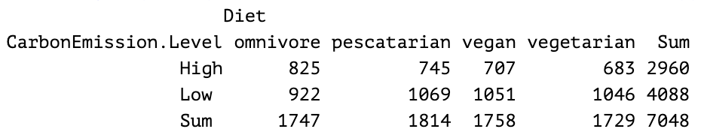
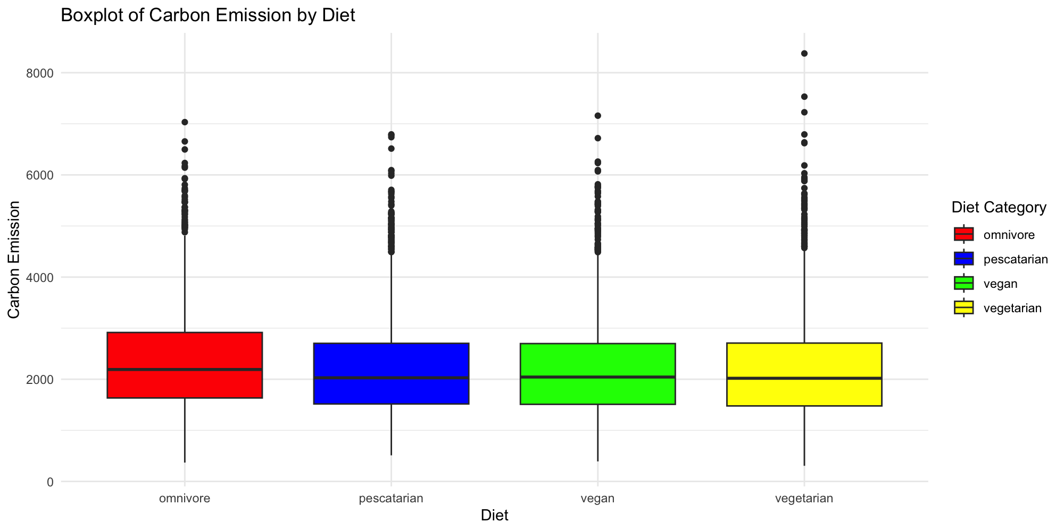
Carbon Emission by Diet
Chi-squared test:
p-value < 0.05

Slide 7

How does social activity influence dietary choices on carbon emission?

Slide 8
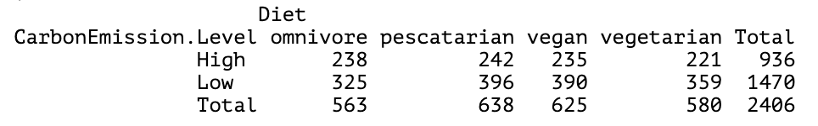
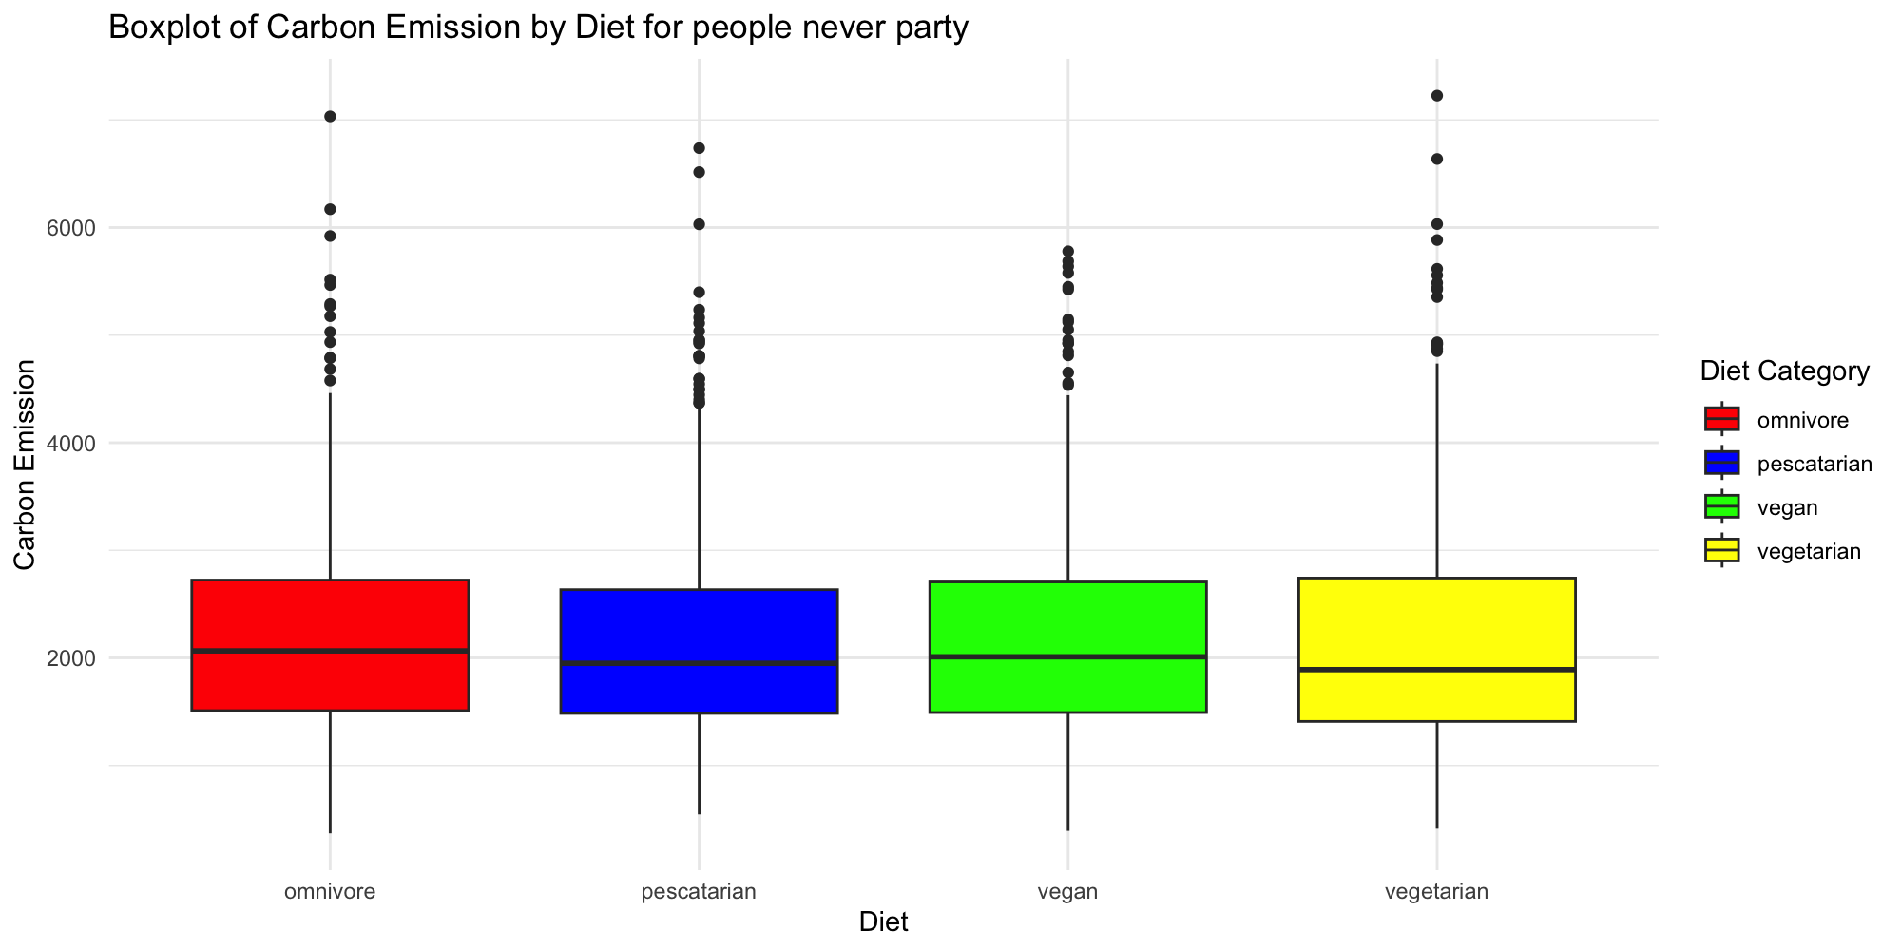
Social Group Never
Confident Interval:
(0.951, 1.511)

Slide 9
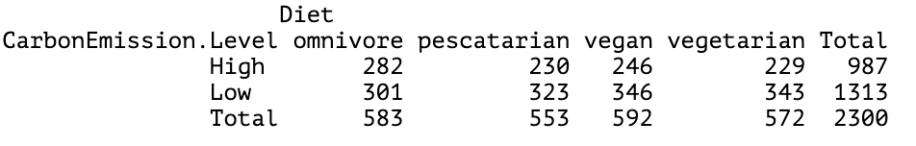
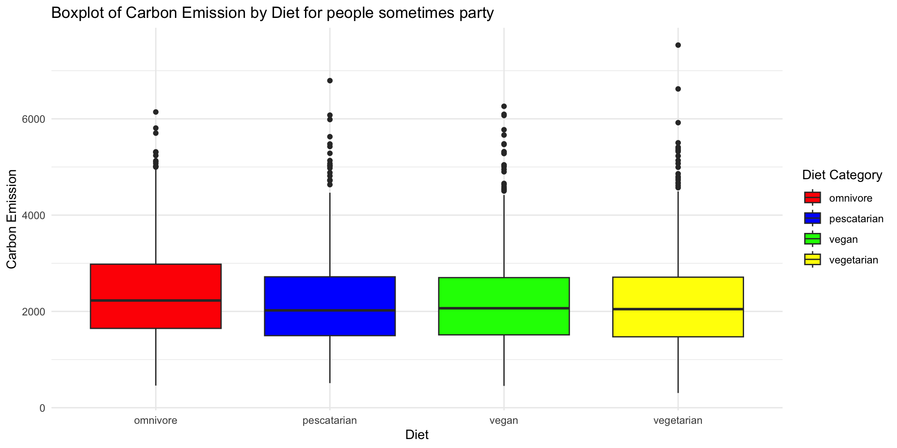
Social Group Sometimes
Confident Interval:
(1.041, 1.663)

Slide 10
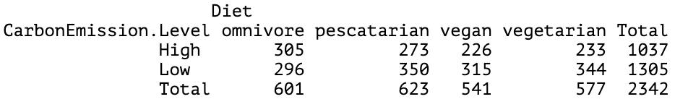
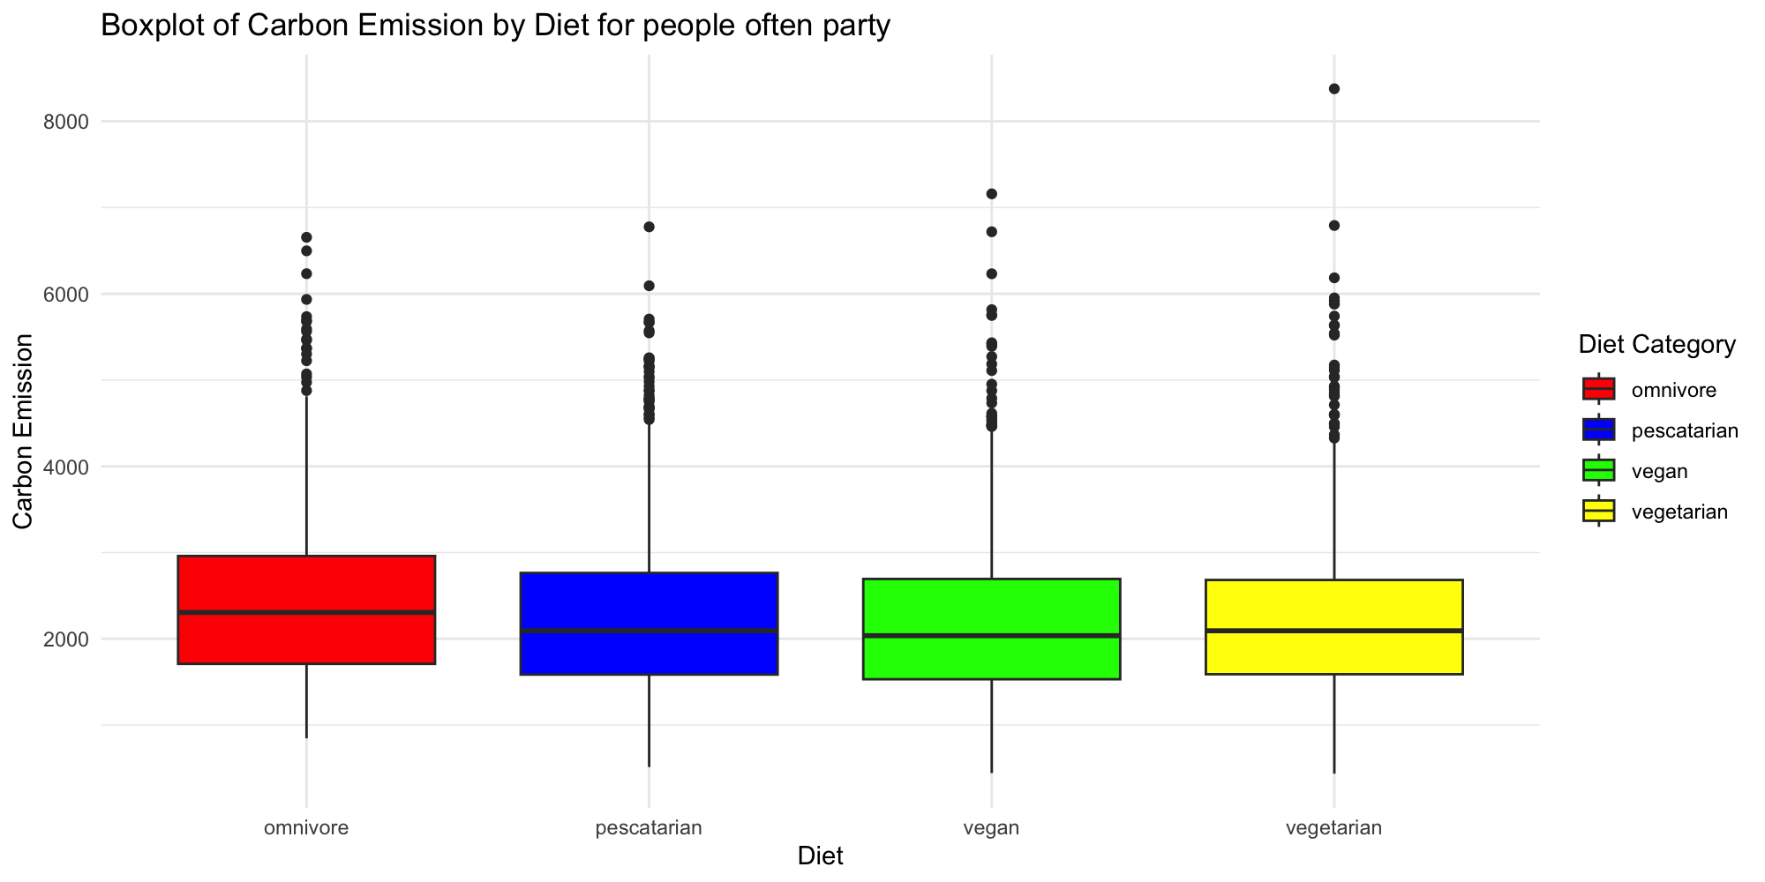
Social Group Often
Confident Interval:
(1.055, 1.654)

Slide 11

How are the monthly clothing purchases associated with the monthly grocery expenses?
Image, "Retail Therapy", Roku.com

Slide 12

Prediction Equation Interpretation
$log⁡(\hat{π}) =3.198+1.26×{10}^{−4}∗GroceryBill$
π = number of clothes purchased
$e^{1.255e−04}=1.000126$
For every $1000 increase in monthly grocery bill, the predicted number of clothes purchased increases by 12.6%.

Slide 13
Is the model adequate?
H0: model is adequate
Ha: model is not adequate
Deviance = 71433.86
Df = 7046
P-value = 0
Conclusion: Model is not adequate

Slide 14

Is there a relationship between levels of social activity and the likelihood of purchasing energy-efficient devices?

Slide 15
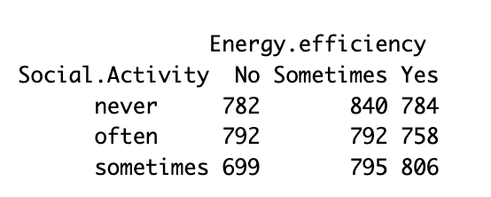
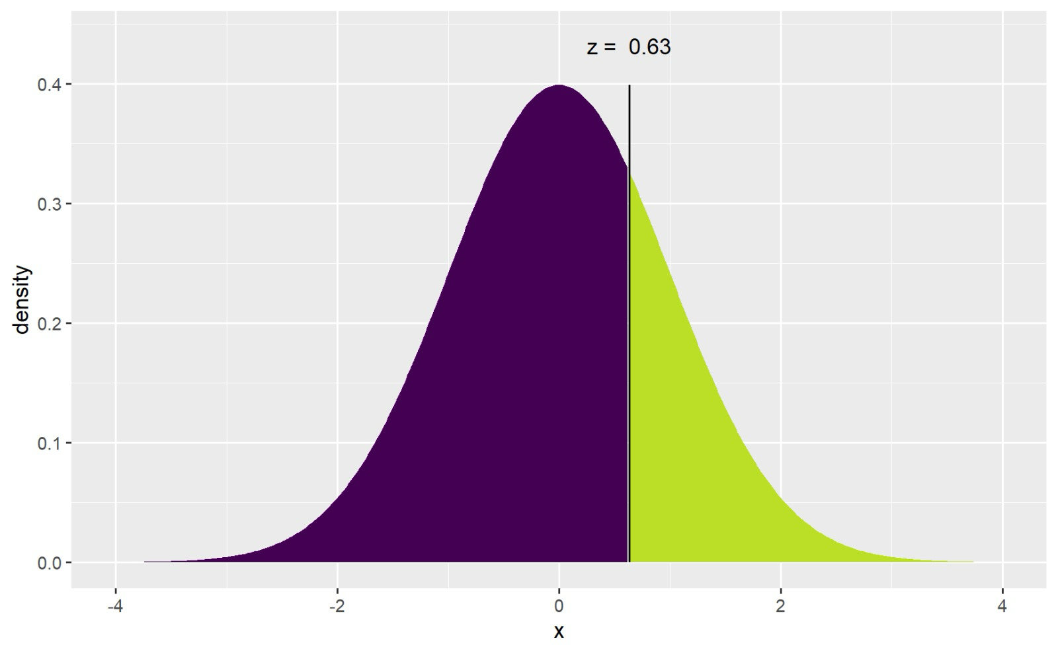
CMH Test on ordinal variables
0 1 2
0 2 1
H0: There is no relationship
Ha: There is a relationship
CMH Test Value = 0.633
P-value = 0.263
Critical value = 1.96

Slide 16
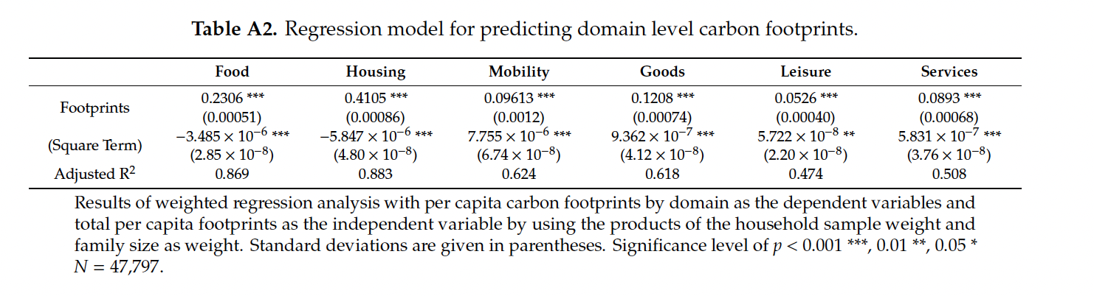
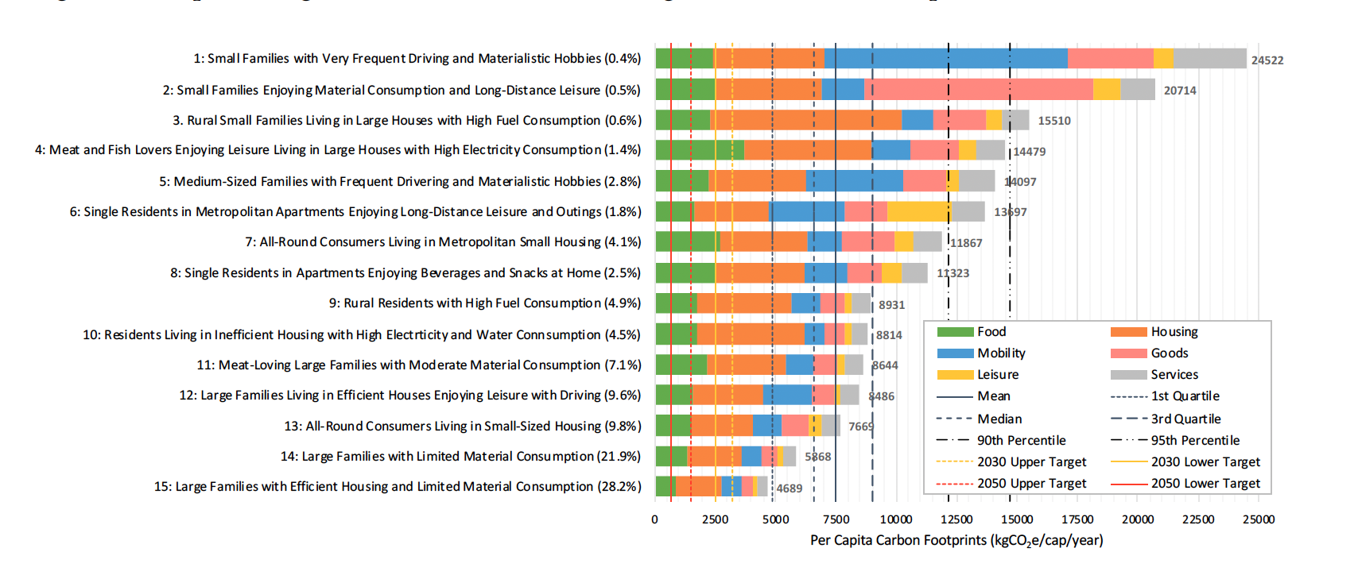
Literature Review​
"Carbon Footprints and Consumer Lifestyles: An Analysis of Lifestyle Factors and Gap Analysis by Consumer Segment in Japan"
(https://www.mdpi.com/2071-1050/11/21/5983).

Slide 17
Conclusion
Dietary choices influence carbon emission
Social activity (Sometimes and Often) significantly influences carbon emission
Clothing purchases are not significantly associated with grocery expenses
There's no relationship between social activity and likelihood of purchasing energy-efficient devices

Slide 18

Thank you. Questions?

